Slide 1
Lecture 4: Modeling Mechanical Systems
determine the differential equations that model the behavior of a mechanical system
Elements making up a mechanical system
Modeling examples
Translational examples
Rotational examples

Slide 2
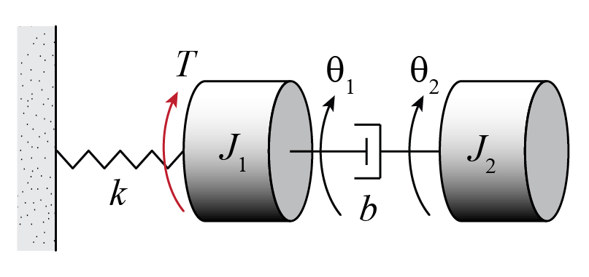
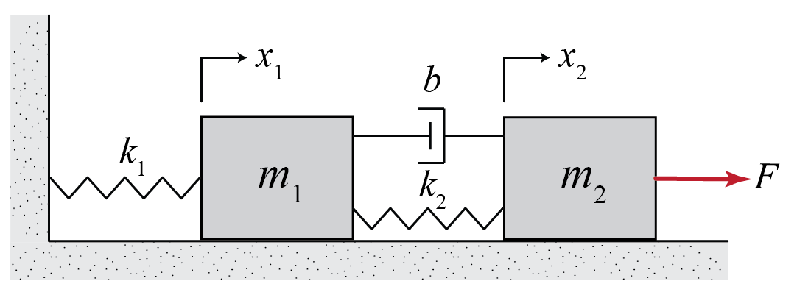
Modeling Mechanical Systems
Mechanical systems consist of three basic types of elements
Inertia elements
Spring elements
Damper elements
Notes:
So far we have been speaking about differential equation models and how to solve them with the Laplace transform … these diff eqs represent real physical systems and today we talk about that some
Things besides springs add stiffness and things besides dampers add damping

Slide 3
Inertia Elements
Examples: mass, moment of inertia
Each inertia element with independent motion needs its own differential equation (Newton’s 2nd Law, Euler’s 2nd law)
Inertia elements store kinetic energy

Slide 4
Spring Elements
Force (torque) is generated to resist deflection
Examples: translational and rotational springs, even a steel rod has stiffness
Spring elements store potential energy

Slide 5
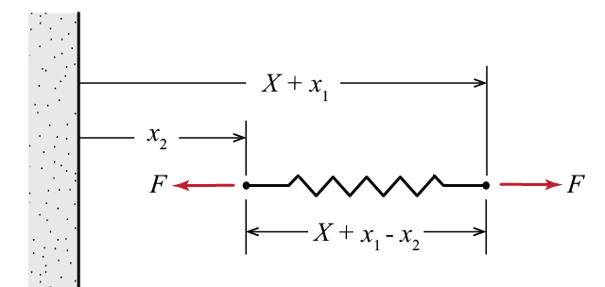
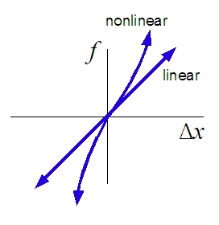
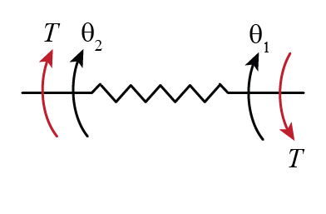
Spring Elements
For a linear translational spring:
For a linear torsional spring:
Notes:
All springs are really nonlinear, but for a small enough region, often a linear model is a good approximation
drive shaft … modulus of elasticity

Slide 6
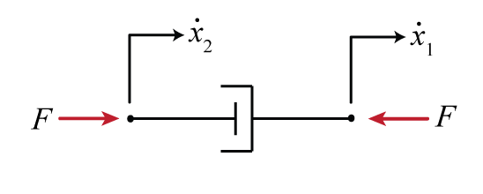
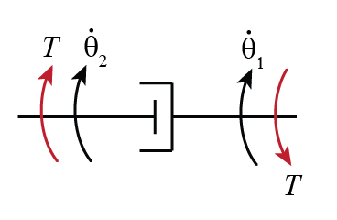
Damper Elements
Force is generated to resist motion
Examples: dashpots, friction, wind drag
Damper elements dissipate energy

Slide 7
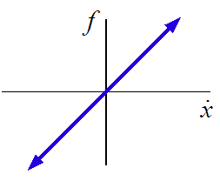
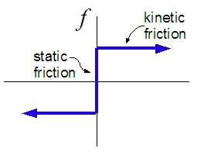
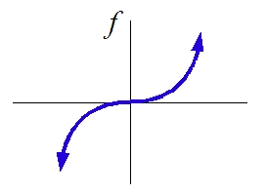
Damper Elements
linear damping
Coulomb friction
drag
(viscous friction)

Slide 8
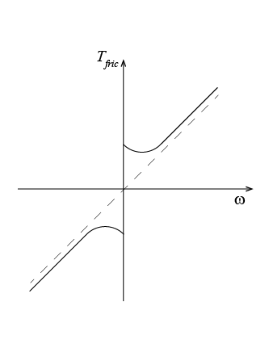
Friction Torque Example
Real friction in general combines aspects of multiple model types
viscous
friction
stiction
stiction

Slide 9
Modeling Mechanical Systems
Approach
Choose coordinates and orientation
Draw free-body diagrams for each inertia
Note assumptions
Generate equations of motion using Newton’s 2nd Law and Euler’s 2nd Law
Double check

Slide 10
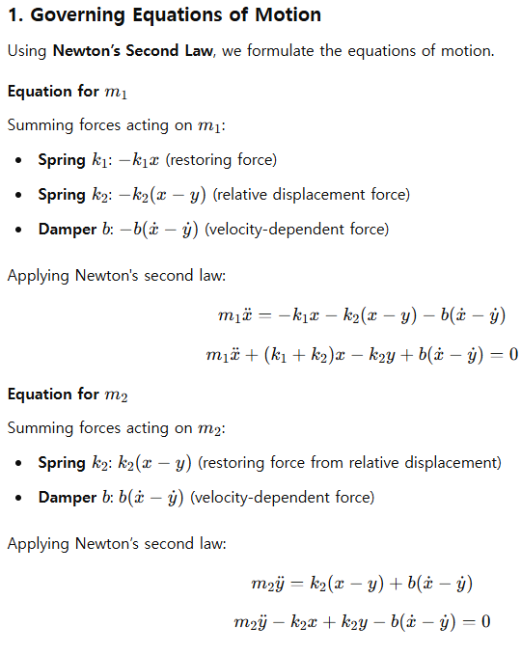
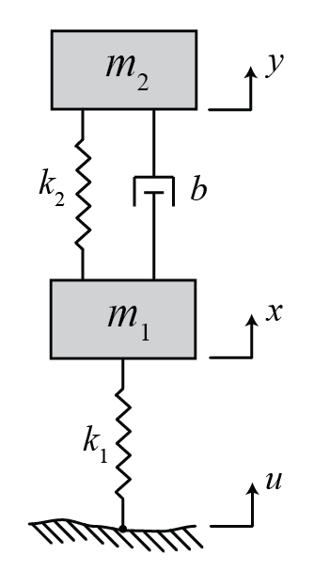
Example
Notes:
TRANSLATIONAL EXAMPLE (MULTI-BODY ¼ CAR SUSPENSION with damping) Ogata Figure 5-17
Mass spring damper systems are very common … useful because they are easy to visualize … will be useful even when we talk about circuits and motors
what everything represents … model tire has having stiffness and damping even though it isn’t a spring or dashpot
choose coordinates and orientation, state assumptions
SHOW WORK HERE … DO ON BOARD. JUST LEAVE SPACE FOR STUDENTS HERE.
Draw free body diagrams
Explain why gravity isn’t included
Sum forces
Double check (signs) … once you solve can get a better idea if this is reasonable

Slide 11
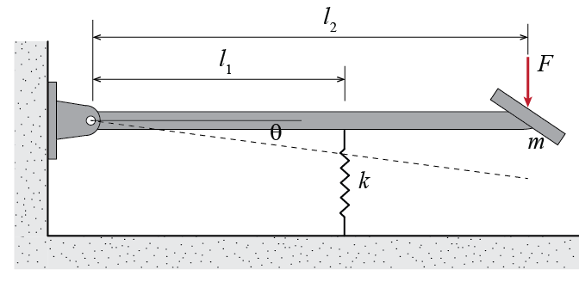
Example
→ assume linear spring, light rod
→ assume in static equilibrium at θ = 0
→ assume small deflection
Notes:
TRANSLATIONAL EXAMPLE (MULTI-BODY ¼ CAR SUSPENSION with damping) Ogata Figure 5-17
Mass spring damper systems are very common … useful because they are easy to visualize … will be useful even when we talk about circuits and motors
what everything represents … model tire has having stiffness and damping even though it isn’t a spring or dashpot
choose coordinates and orientation, state assumptions
SHOW WORK HERE … DO ON BOARD. JUST LEAVE SPACE FOR STUDENTS HERE.
Draw free body diagrams
Explain why gravity isn’t included
Sum forces
Double check (signs) … once you solve can get a better idea if this is reasonable

Slide 12
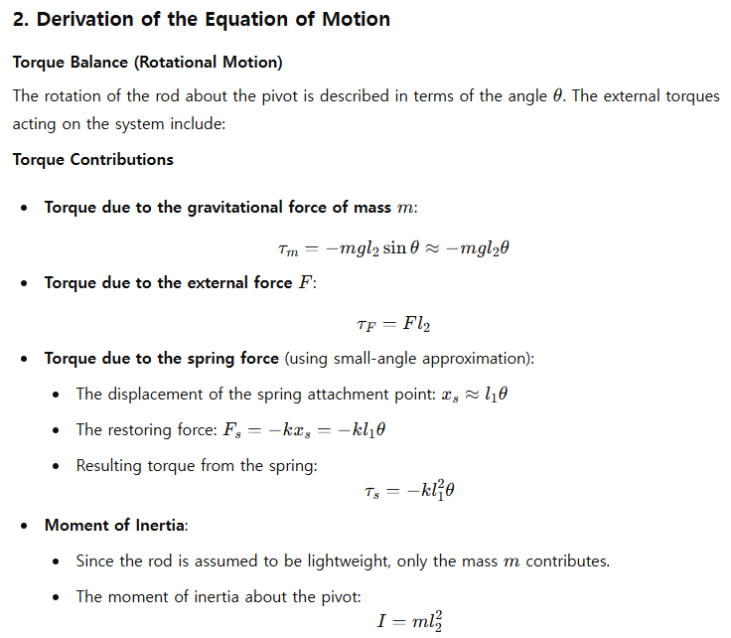
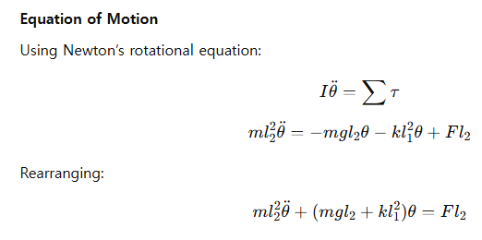
Notes:
TRANSLATIONAL EXAMPLE (MULTI-BODY ¼ CAR SUSPENSION with damping) Ogata Figure 5-17
Mass spring damper systems are very common … useful because they are easy to visualize … will be useful even when we talk about circuits and motors
what everything represents … model tire has having stiffness and damping even though it isn’t a spring or dashpot
choose coordinates and orientation, state assumptions
SHOW WORK HERE … DO ON BOARD. JUST LEAVE SPACE FOR STUDENTS HERE.
Draw free body diagrams
Explain why gravity isn’t included
Sum forces
Double check (signs) … once you solve can get a better idea if this is reasonable

Slide 13
Lecture 5: Transfer Functions and Block Diagrams
Review differential equation solution process
Transfer function models
Intro to block diagrams
Intro to time response analysis (if time)

Slide 14
Differential Equation Review
Recall, the Laplace transform converts LTI differential equations to algebraic equations
differential
equation
solve in time domain
x(t)
1
L
L⁻¹
3
algebraic
equation
solve in s-domain
X(s)
2

Slide 15
Differential Equation Review
Let’s determine the solution of the linear differential equation from last lecture
System has no damping, note that the roots of characteristic equation are purely imaginary
Can solve for θ(t) using the Laplace transform

Slide 16
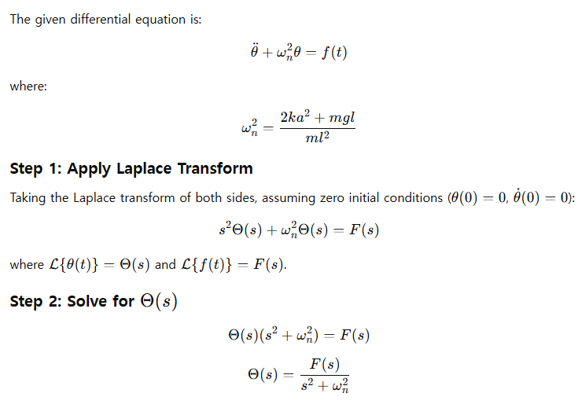
Example

Slide 17
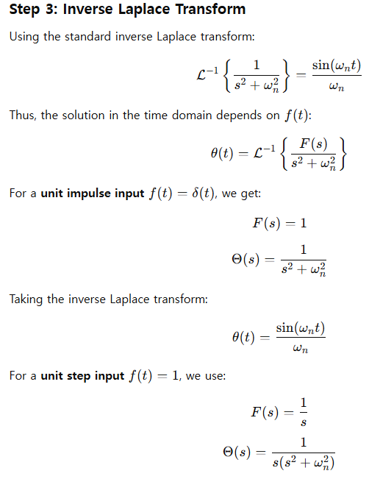
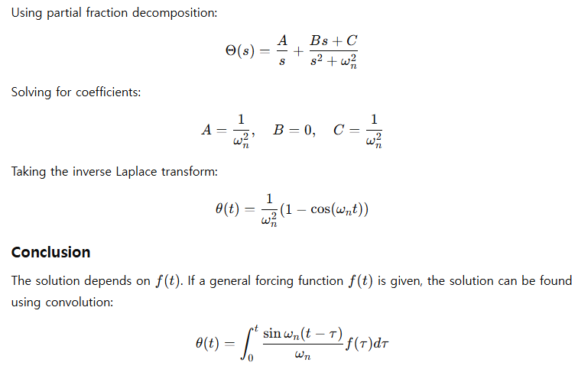

Slide 18
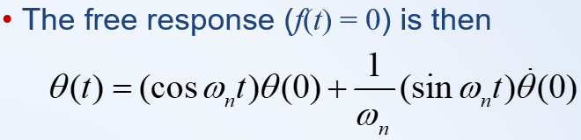
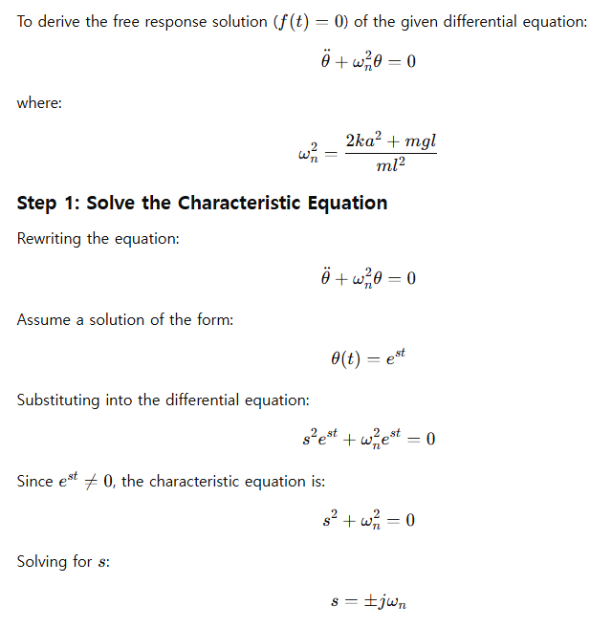
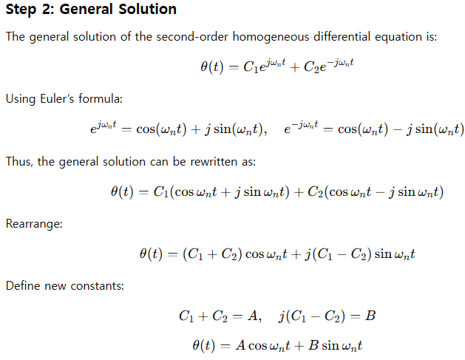

Slide 19
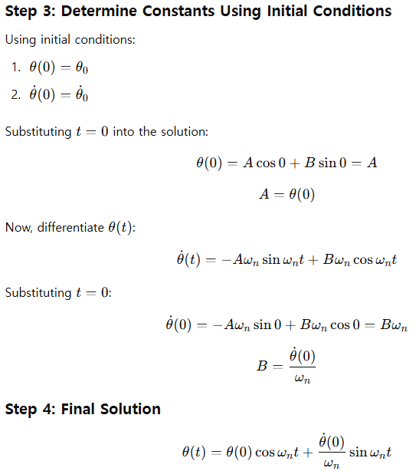

Slide 20
Example (continued)
The free response (f(t) = 0) is then
θ(t) is a shifted sinusoid of frequency ω_{n}, called the (undamped) natural frequency
Now consider mass-spring-damper example from last time (which does have damping)

Slide 21
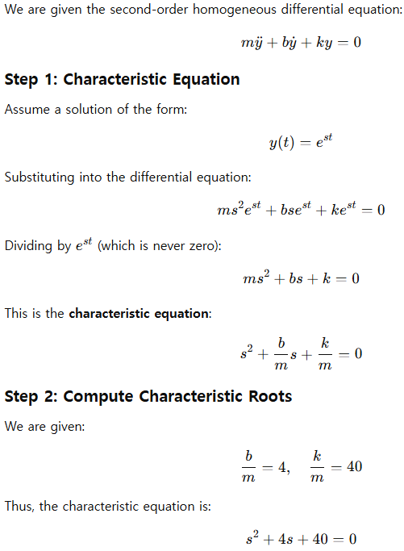
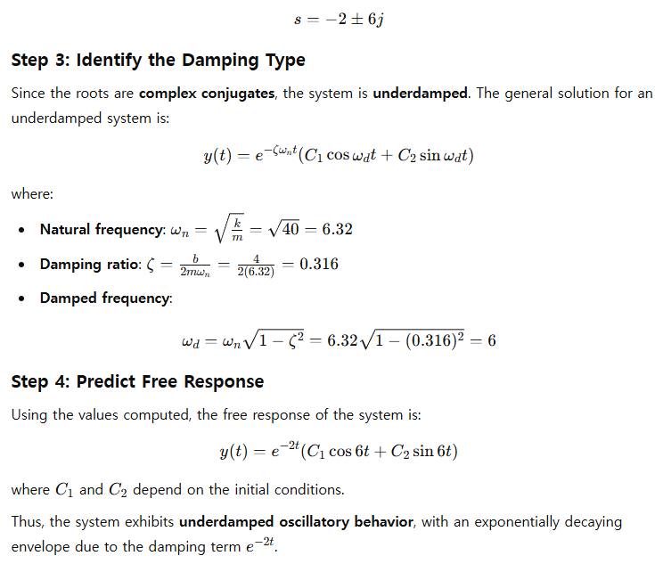
Example

Slide 22
% Initial condition vector
z0 = [y0; ydot0];
% Solve using ode45
[t, z] = ode45(odefun, tspan, z0);
% Extract solution
y = z(:, 1); % Displacement
ydot = z(:, 2); % Velocity
% Plot results
figure;
subplot(2,1,1);
plot(t, y, 'b', 'LineWidth', 1.5);
xlabel('Time (s)');
ylabel('Displacement y(t)');
title('Damped Oscillatory Motion');
grid on;
subplot(2,1,2);
plot(t, ydot, 'r', 'LineWidth', 1.5);
xlabel('Time (s)');
ylabel('Velocity dy/dt');
grid on;
% Define system parameters
m = 1; % Mass (arbitrary scaling)
b = 4 * m; % Damping coefficient
k = 40 * m; % Stiffness
% Define time span for simulation
tspan = [0 10]; % Simulate for 10 seconds
% Define initial conditions
y0 = 1; % Initial displacement
ydot0 = 0; % Initial velocity
% Convert second-order ODE to first-order system
% Let z1 = y, z2 = dy/dt
% Then: dz1/dt = z2
% dz2/dt = (-b/m)*z2 - (k/m)*z1
odefun = @(t, z) [z(2); - (b/m) * z(2) - (k/m) * z(1)];

Slide 23
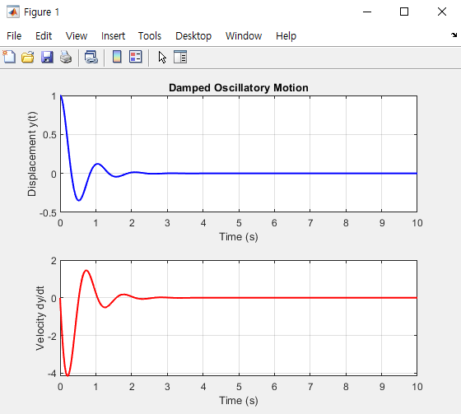

Slide 24
Example (continued)
y(t) is a damped sinusoid with frequency 6 rad/sec … called the damped natural freq ω_{d}
The (undamped) natural frequency ω_{n} is frequency if the system has no damping

Slide 25
Transfer Function Models
Often it is desired to remain in the Laplace domain for analysis and manipulation
The transfer function G(s) of a system is an alternative model to the differential equation and is defined as the ratio of the Laplace transform of the output Y(s) to the Laplace transform of the input U(s) assuming zero initial conditions

Slide 26
Transfer Function Models
Characterize the input-output relationship of a dynamic system (ignores initial conditions)
Are a property of the system itself, not specific to the particular forcing input (represent natural response)
Have units, but do not provide information concerning the physical structure
Apply only to linear time-invariant (LTI) systems
Make combining systems much easier

Slide 27
Finding a Transfer Function Model
Begin with
Choose what is the input and what is the output
Take Laplace transform assuming zero ICs
Rearrange

Slide 28
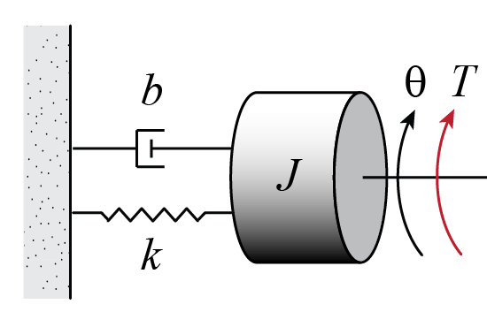

Example
Find the equation of motion for the following system

Slide 29
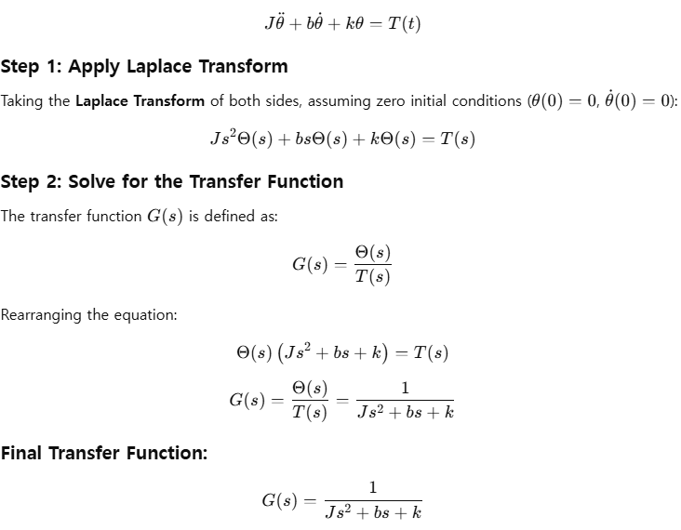
Find the transfer function for the previous example where T(t) is the input and θ(t) is the output

Slide 30
Block Diagrams
is often drawn as a block diagram
where U(s), Y(s) are signals and G(s) is a system
Mathematically, Y(s) = G(s)U(s)
In the time domain, need a convolution integral
U(s)
Y(s)
G(s)

Slide 31
Block Diagrams
Useful for visualizing complex systems
wind force,
gravity force
+
Control
Algorithm
Engine
-
Car
desired
speed
-
throttle
angle
(voltage)
+
actual
speed
force
Speedometer
measured
speed

Slide 32
Block Diagrams
Useful for visualizing complex systems
here each block is a transfer function and the arrows represent signal flow
D
R
+
E_{m}
C(s)
G(s)
-
U
P(s)
Y
-
+
Y_{m}
H(s)
Notes:
Can get even more complicated than this … feedforward control … multiple feedback loops … other extraneous inputs like noise

Slide 33
Time Response
Consider the TF from our earlier example
It is desired to find the time response θ(t) for different torque inputs
In general,

Slide 34
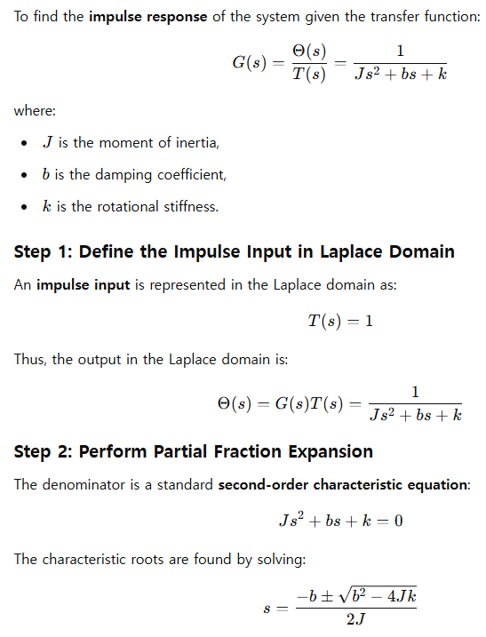
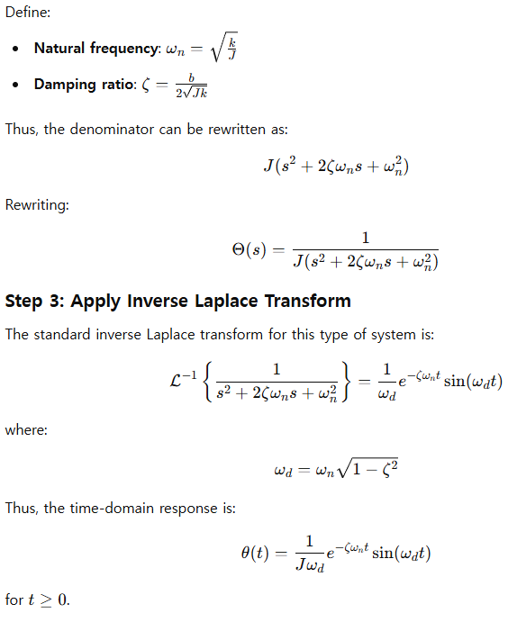
Time Response
Impulse response :

Slide 35
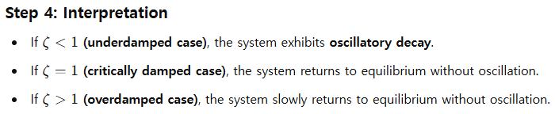
MATLAB Notes

Slide 36
% Define system parameters
J = 1; % Moment of inertia (kg·m²)
b = 4; % Damping coefficient (N·m·s/rad)
k = 40; % Rotational stiffness (N·m/rad)
% Define the transfer function G(s) = 1 / (J s^2 + b s + k)
num = 1; % Numerator of G(s)
den = [J, b, k]; % Denominator of G(s)
% Create the transfer function
G = tf(num, den);
% Time vector for simulation
t = linspace(0, 5, 1000); % 5 seconds simulation with fine resolution
% Simulate impulse response
[y, t] = impulse(G, t);
% Plot impulse response
figure;
plot(t, y, 'b', 'LineWidth', 1.5);
xlabel('Time (s)');
ylabel('Angular Displacement \theta(t)');
title('Impulse Response of Rotational System');
grid on;

Slide 37
Lecture 6: Time Response
Time response determination
Review of differential equation approach
Introduce transfer function approach
MATLAB commands
Simulation
Simulink commands

Slide 38
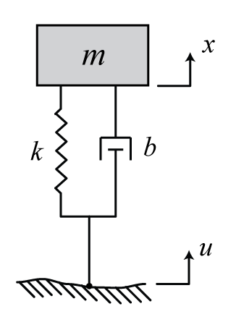
Time Response
Consider the following simplified model of a car suspension
Would like to determine the time response of the car body (x(t)) for different road inputs (u(t))
quarter mass of the car
the suspension
tire stiffness and damping
of the tires are neglected

Slide 39
Time Response
Differential equation model can be solved for different forcing inputs
Example: Driving over a bumpy road u(t) = sin(t)
Example: Driving over a curb u(t) = 1(t)
(use property of superposition to solve)

Slide 40
Example
Can also model with a transfer function

Slide 41
Time Response
The transfer function for this example is
The time response x(t) can be determined for different inputs u(t) (and zero initial conditions) using the transfer function
In general,

Slide 42
Example (step response)

Slide 43
Example (continued)

Slide 44
Example (continued)
Determine final value:
Determine frequency of oscillation:
Estimate how long it takes before response stays within 2% of its final value:

Slide 45
MATLAB Notes

Slide 46
Numerical Simulation
The models we have developed so far are linear and may be solved analytically
Many real systems include nonlinear elements such that their equations of motion are difficult if not impossible to solve
These systems can be approximated by linearized equations, or the solution to the nonlinear equations can be approximated numerically

Slide 47
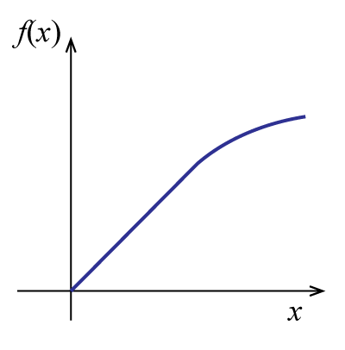
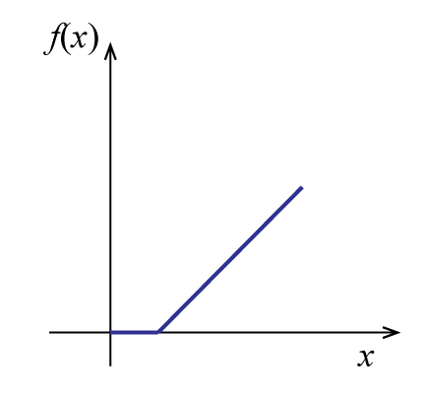
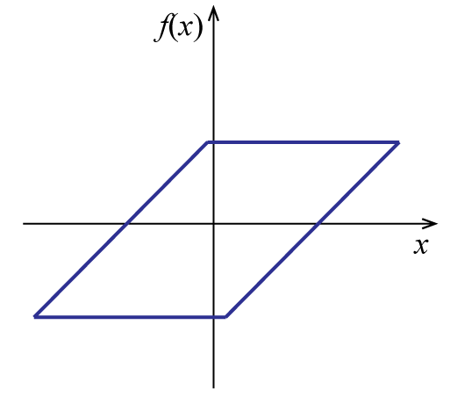
Numerical Simulation
Example nonlinearities include:
Wind drag, nonlinear springs, Coulomb friction
saturation
dead zone
backlash

Slide 48
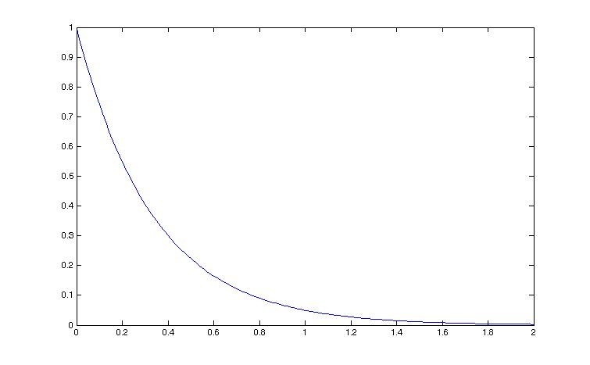
Numerical Simulation
A simple numerical
approximation employs
Euler’s method
x₀
x₁
x₂
t₀ t₁ t₂ t₃ t_{4 …}

Slide 49
Numerical Simulation
Example:
Therefore, for x(0)=1
and Δt=0.5
x₀
x₁
x₂
t₀ t₁ t₂ t₃ t_{4 …}

Slide 50
Numerical Simulation
Accuracy can be
improved by:
Reducing the
time step Δt
Using a higher-
order solver
Tradeoff between
accuracy and speed
x₀
x₁
x₂
t₀ t₁ t₂ t₃ t_{4 …}

Slide 51
Numerical Simulation
Tradeoff between accuracy and run time
Time step and solver order
Complexity of models
Some dynamics may be neglected (treated as static)
Some complex components may be represented by look-up tables and maps based on steady-state performance or cycle-averaged efficiencies
Most simulations will use some combination of physics-based dynamic models and empirical maps
Form determined by purpose and requirements

Slide 52
Numerical Simulation
We will use Simulink to perform our simulation
Simulink represents models as block diagrams and an underlying solver, like Euler’s method, is used to approximate the values of variables
Can choose solution method and time step
Simulink library includes many types of nonlinearities

Slide 53
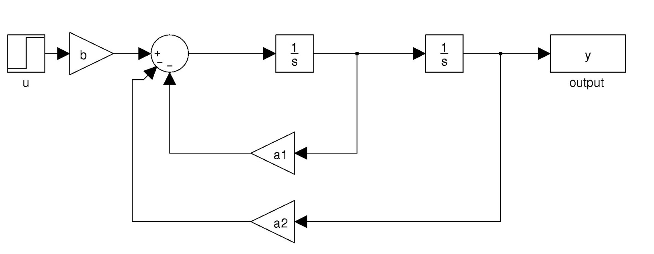
Example
Initial conditions can be set in the integrators
Can include nonlinearities

Slide 54
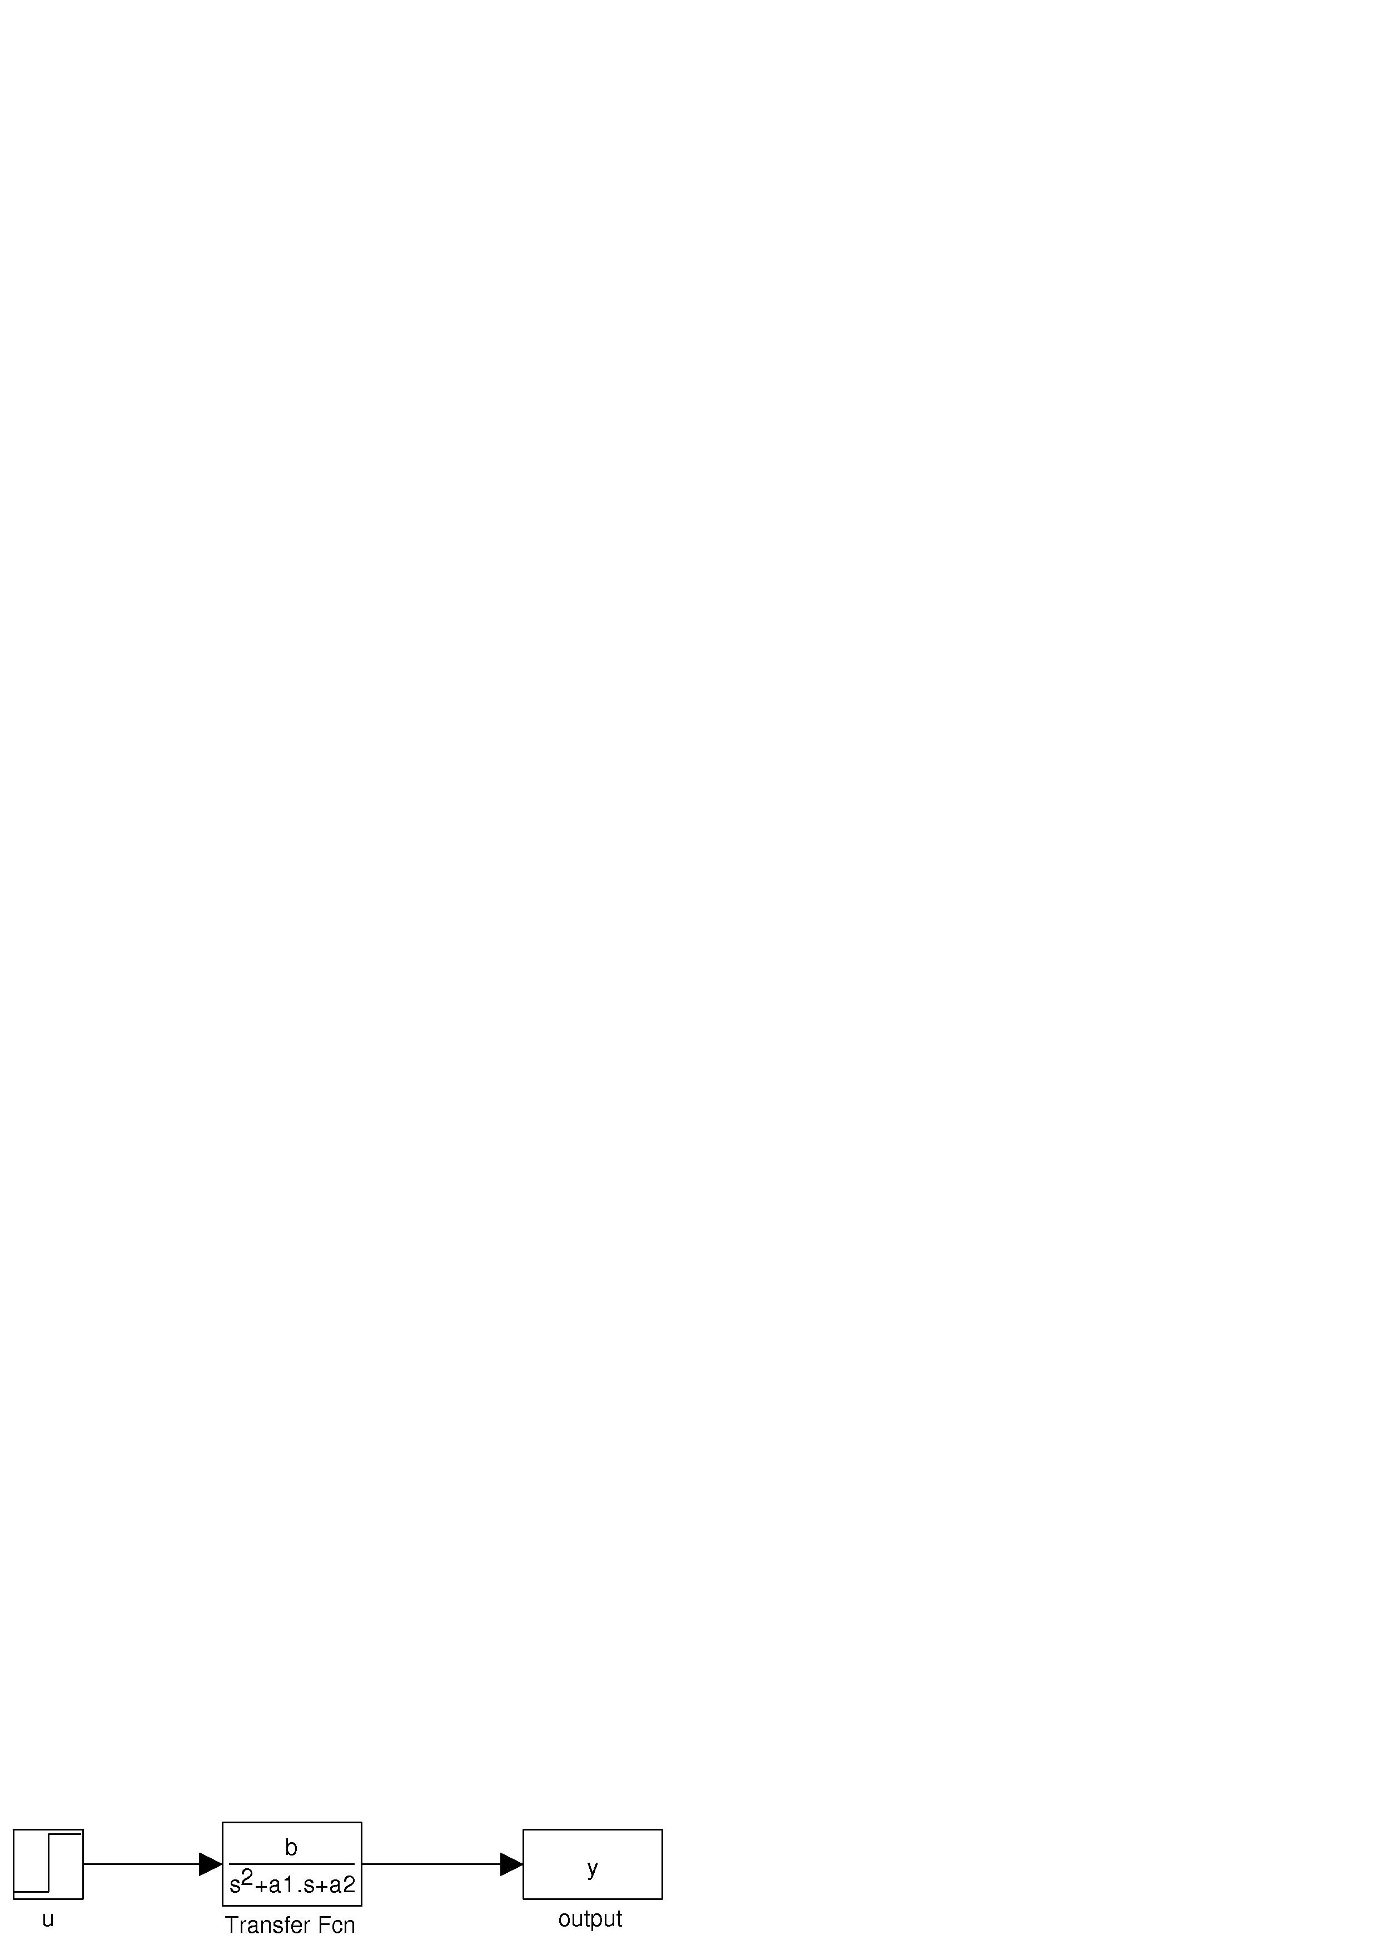
Example
Can also represent as a transfer function
Preferred for combining subsystems
Cannot set initial conditions
Cannot represent nonlinearities

Slide 55
Simulink Notes

